Slide 1
Influenza Experience: Highlights and Comments
Dr. Daniel Stamboulian

Slide 2
Faculty Disclosure
Dr. Stamboulian works occasionally as speaker for Merck, Novartis, Pfizer and Sanofi Pasteur
Dr. Stamboulian is member of the Advisory Board on Adult Immunization for Merck

Slide 3
A century since the 1918 flu pandemic
About 500 million people became infected (1/3 of the world’s population)
Number of deaths:
at least 50 million worldwide
CDC. History of 1918 Flu Pandemic
https://www.cdc.gov/flu/pandemic-resources/1918-commemoration/1918-pandemic-history.htm

Slide 4
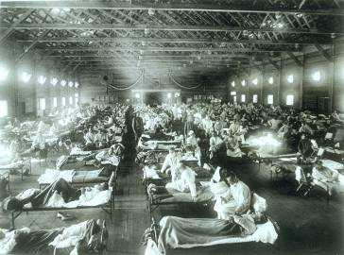
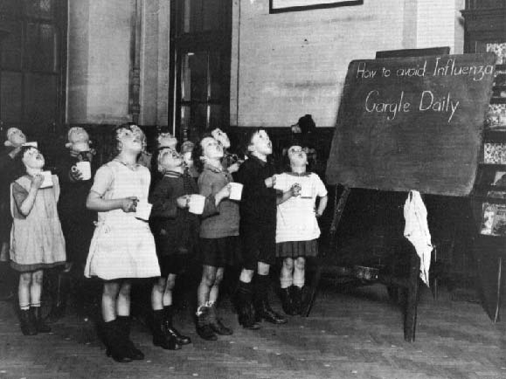
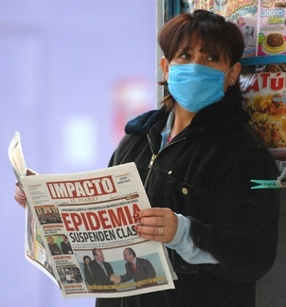
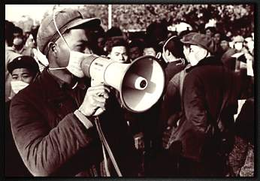
Influenza Pandemics
?
1918 Spanish Flu
1957 Asian Flu
1968 Hong Kong Flu
2009-2010
Pandemic
Next Pandemic
A (H5N1)?
A (H7N9)?
A(H1N1)
A(H2N2)
A(H3N2)
A(H1N1)
151,700 - 575,400 deaths
50 M deaths
1-2 M deaths
1 M deaths
http://espanol.pandemicflu.gov/pandemicflu/enes/24/_www_pandemicflu_gov/general/whatis.htm
https://www.cdc.gov/flu/spotlights/pandemic-global-estimates.htm
Notes:
4
Numero-007
Buscar datos mundiales y/o Europeos
A través del vínculo en Sahy DK accedemos a la agenda de la reunión donde Shay hizo la presentación y de este documento lleva a la presentación.
O bien, a través de “Presentation” se va directamente a la presentación (ppt) de Dr. Shay.
Datos mundiales de las muertes de las tres pandemias lo tenemos en dos documentos.
Datos mundiales 1 = PandemiaMuertesMundialWHO2006.pdf
Datos mundiales 2 = PandemiaMuertesMundialComunicadoPrensaOPS2006.pdf
Ver documento RiskAlert2006.pdf (página 2)

Slide 5
Influenza: Disease Burden
5% to 10% of adults get the flu each year.
20% to 30% of children.
Causes 3 to 5 million cases of severe illness.
250.000 to 650.000 respiratory deaths.
http://www.who.int/news-room/fact-sheets/detail/influenza-(seasonal)

Slide 6
Influenza A Viruses
Currently circulating in humans:
Subtype A(H1N1)
Subtype A(H3N2)

Slide 7
Influenza B Viruses
Divided into lineages
2 lineages are currently circulating:
B/Yamagata
B/Victoria
Burden of the disease: 30% - 35%
Detected more often in children

Slide 8
Recommended composition of influenza virus vaccines
For use in the 2018-2019 northern hemisphere influenza season
an A/Michigan/45/2015 (H1N1)pdm09-like virus
an A/Singapore/INFIMH-16-0019/2016 (H3N2)-like virus
a B/Colorado/06/2017-like virus (B/Victoria/2/87 lineage)
a B/Phuket/3073/2013-like virus (B/Yamagata/16/88 lineage)
Recommended: the influenza B virus component of trivalent vaccines
B/Colorado/06/2017-like virus of the B/Victoria/2/87-lineage
http://www.who.int/influenza/vaccines/virus/recommendations/2018_19_north/en/

Slide 9
Prevention and vaccine effectiveness
The most effective way to prevent the disease is vaccination.
Reduces risk of flu-associated hospitalization
Prevents severe, life-threatening complications
https://www.cdc.gov/flu/about/qa/vaccineeffect.htm

Slide 10
Universal Influenza Immunization 6 Months through Adulthood - New challenges, new opportunities
“A universal vaccination recommendation for all persons aged ≥6 months eliminates the need to determine whether each person has an indication for vaccination and emphasizes the importance of preventing influenza among persons of all ages.”
Centers for Disease Control and Prevention (CDC). MMWR. 2010;59(RR-8):1-62.

Slide 11
WHO recommends annual vaccination for
Pregnant women at any stage of pregnancy
Children aged between 6 months to 5 years
Elderly individuals (≥ 65 years)
Individuals with chronic medical conditions
Health-care workers
https://www.who.int/news-room/fact-sheets/detail/influenza-(seasonal)

Slide 12
Argentinian National Influenza Immunization Campaigns
Since 1993 to date
Especially for individuals ≥ 65 years old
Organized by government (Public Ministry of Health, INSSJP (Medicare)) and non-profit organizations (FUNCEI, COFA)
Over 7 million doses administered in the first decade
Stamboulian D et al Immunization against influenza in the elderly: the Argentinian experience 1993-1997
Vaccine 1999;17: S53-56

Slide 13
Argentinian National Influenza Immunization Campaigns
Doses administered per 1,000 subjects ≥65 years old
Stamboulian D et al Immunization against influenza in the elderly: the Argentinian experience 1993-1997 Vaccine 1999; 17: S53-56

Slide 14
Thank you
dstamb@stamboulian.com.ar

